Slide 1
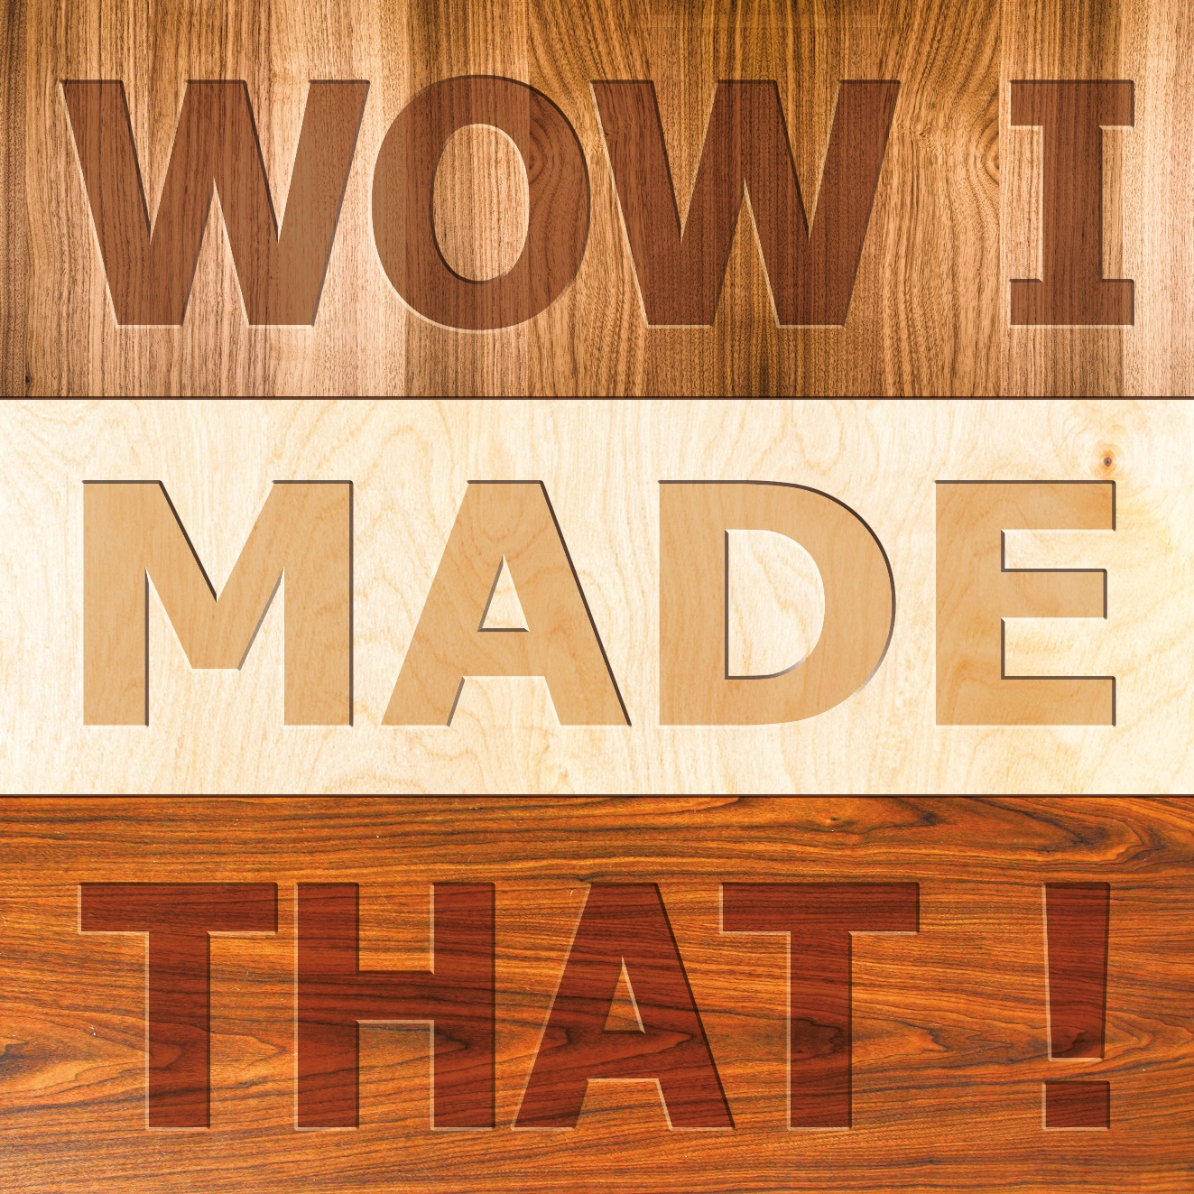
Sustainable Design

Slide 2
What is Sustainable Design?
Safe guarding the world for ourselves and future generations by…
Using energy & other resources in a way that minimises their depletion.
Successful sustainable design reduces the environmental impact throughout the products entire life.

Slide 3





Life Cycle Assessment
Used to assess and evaluate the environmental impact of the product or packaging ‘from cradle to the grave’ through…
The extraction & processing of raw materials
The production phase
Distribution
Use
Disposal
of the
product

Slide 4
Life Cycle Inventory
Determines which raw materials are used and what emissions will occur during the life of the product.
Including:
Environmental inputs and outputs of raw materials & energy resources
Economic inputs and outputs of products

Slide 5
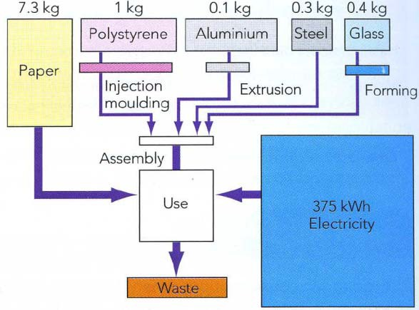
Life Cycle Inventory
Example: Life Cycle Inventory of a Coffee Machine
Reduce paper filter
Reduce energy required to manufacture

Slide 6
Manufacture
The analysis of existing manufacturing processes can identify areas that can be modified to achieve more efficient and cleaner processes.
Designers can use processes with less environmental impact by:
Using processes that use less energy
Simplifying the product with fewer parts
Reducing waste
Using natural resources efficiently to minimise emissions
Recycle waste material
Enhancing quality control to reduce number of faulty items

Slide 7
Distribution
Congestion on our roads and motorways is increasing and road haulage companies are significantly adding to this.
Other forms of transport such as trains (especially electric trains) or waterways are less polluting.
Distribution can use processes with less environmental impact by:
Reducing or lightening packaging
Reducing mileage of transportation
Driving sensibly
Using ‘alternatives to fossil fuels’

Slide 8
Use & Maintenance
The designer’s responsibilities do not end after the product reaches the consumer.
Many products are designed so it is virtually impossible to access the internal component if something goes wrong. This ‘built-in obsolescence’ means that the product cannot be repaired and therefore has to be discarded and replaced.
Designers can reduce environmental impact by:
Increasing the durability of product
Encouraging refill consumables
Promoting the efficient use of product
Making component parts easy to replace
Extend the life of product

Slide 9
Disposal
There are six options to consider when deciding how to minimise waste production at the end of the life cycle stage. The six Rs are as follows:
• Reduce • Rethink
• Reuse • Refuse
• Recycle • Repair
The six Rs should be considered by the designer, the manufacturer and the customer. From a design perspective, to minimise waste and reduce the environmental impact, the designer can:
• Make products easy to disassemble for recycling
• Limit the use of toxic materials
• Use biodegradable materials where possible
• Arrange collection of materials at end of life stage

Slide 10
The 6 Rs - Reduce
Reduce the amount of materials needed to package a product
Cost savings and improved profit
Reduced environmental costs
Under the UK Producer Responsibly Organisations (Packaging Waste) Regulations (1997), manufacturers are obliged to reduce packaging by:
• Considering the materials and design
• Examining the ways of eliminating packaging
• Optimise packaging - match packaging to level of protection needed

Slide 11
The 6 Rs - Reuse
Reuse of a product
Minimises the extraction of raw materials and the energy and resources required for recycling
• Companies have adopted returnable or refillable containers for some products. An example is the door step delivery of milk. However, whilst refillables appear to offer environmental benefits they can often require greater use of resources so they can withstand the rigours of reuse.
• If reuse is viable then the costs of collection, washing and refilling should be less than producing a new container.

Slide 12
The 6 Rs - Recycle
Recycling takes waste materials and products and reprocesses them to manufacture something new.
Recycling

Slide 13
The 6 Rs - Rethink
Rethinking the way a product is manufactured and redesigned can have a positive impact on the amount and type of materials used.
Rethink

Slide 14
The 6 Rs - Refuse
Refusing to use certain types of materials with the design and manufacturing process and using a more sustainable material instead.
Refusing

Slide 15
The 6 Rs - Repair
When a product is broken, consider whether it can it be repaired rather than being discarded. Repair can help save on cost and minimise the use of non-renewable materials and energy used in the manufacturing process.
Repair

