Slide 1

Natural Timber Production

Slide 2
Classification of Timbers
Timbers can be classified under the headings:
1. Hardwoods
2. Softwoods
This is an indication of the type of tree the wood comes from and is not a guide to the hardness or softness of the wood.

Slide 3
Classification of Timbers
 | Hardwoods | Softwoods
Type of Tree | Deciduous trees (i.e. sheds its leafs seasonally) | Coniferous trees (i.e. evergreen - grow needles and cones as opposed to leaves)
Time to Mature | Slow growing and can take up to 100 years to mature | Softwood grows at a faster rate and take approx. 30 years to mature depending on species.
Price | Generally more expensive due to time to reach maturity | Generally cheaper as quick to grow and easy to replace
Properties | Because of their condensed and more complex structure, (untreated) hardwoods generally offer a superior level of strength and durability. | They are flexible, lighter in weight and less dense than most hardwoods.
Examples | Oak, Teak, Sapele, Iroko, Beech, Maple and Walnut | Pine, Spruce, and Fir

Slide 4
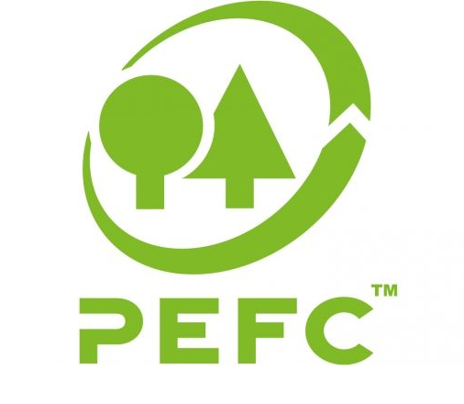

Sustainable Forestry
Wood is a renewable resource; when forests are well managed (i.e. with consideration for the environment and the wildlife and the people who live and work in them), harvesting timber can actually be an effective way of safeguarding the forests for future generations.
The Forest Stewardship Council (FSC) and the Programme for the Endorsement of Forest Certification (PEFC) are the largest global forest certification systems. They are separate, non-profit entities, but they share a common goal: to identify forests which are sustainably managed and environmentally sound.
Products which carry the FSC or PEFC brands are made from materials which originate in well managed forests, or from trusted recycling sources.

Slide 5
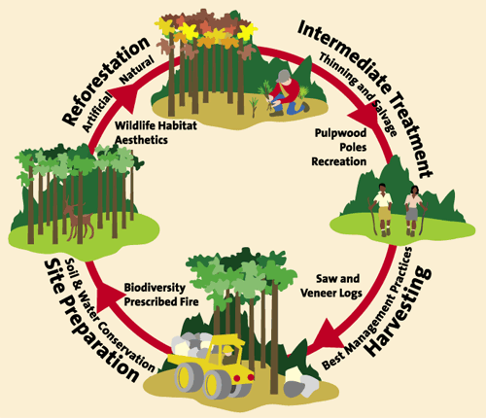
Managed Forestry Cycle
Logging activities can take many forms, from
selective harvesting to limited, small-scale clear
cutting, which, in temperate forests, can mimic natural disturbances such as fires or landslides.
The goal is to harvest in such a way that allows these species the chance to regenerate, and ensures that the forest’s overall ecological health is maintained, restored, or even enhanced.

Slide 6
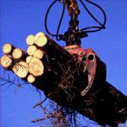

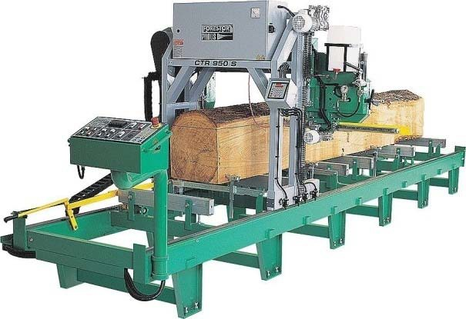
Conversion
Conversion is the term given to sawing the log into marketable timber.
Tree Felled
Transport to Sawmill
Cut into Planks

Slide 7
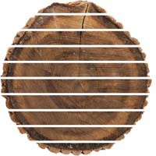
Conversion
Conversion – Through and Through (Slab Sawn)
Advantages | Simplest, quickest and cheapest method
Disadvantages | Some planks are likely to warp, bow or twist
Description | Parallel cuts through the log
Use | Frequently used on softwoods as they are smaller in diameter

Slide 8
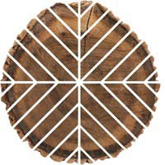
Conversion
Conversion – Quarter Sawn (Radial Sawn)
Advantages | Better quality and is less likely to warp, bow or twist. Promotes grain pattern.
Disadvantages | Time consuming process and involves much more man handling of the log. Wasteful process. More expensive.
Description | Quarter sawing tries to make the growth rings as short as possible to reduce warping.
Use | Hardwoods.

Slide 9
Seasoning
Timber takes in moisture from a damp atmosphere but gives it up in a dry one.
Disadvantages of unseasoned timber:
Damp wood shrinks in dry air
Dry wood swells in damp air
Unseasoned green timber will twist, warp and crack
Advantages of seasoning:
Timber is more stable and is less likely to warp and crack and it makes it immune from rot and decay
Seasoning aims to remove excess, unwanted sap and moisture from timber

Slide 10
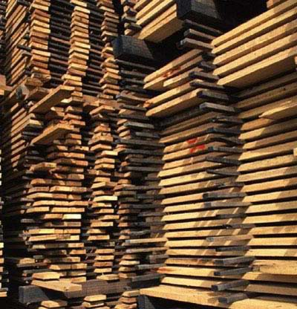
Natural Air Seasoning
A traditional form of drying hardwood used for centuries.
Hardwood stacked within an open sided shed and natural air allowed to flow around them
A sloping roof protects against direct sunlight and rain
Advantages | Disadvantages
Traditional method Cheap to operate | Depends on weather conditions Takes one year to season each 25mm of timber, plus a year

Slide 11
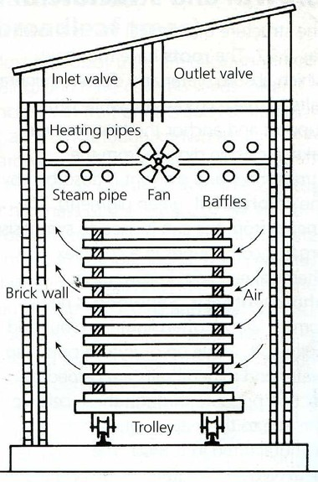
Artificial Kiln Seasoning
Wood stacked on trolleys and wheeled into kiln
Steam is introduced which soaks the timber
Pressure and humidity reduced
Advantages
Quicker, more controlled reliable method. Quicker process – 2 weeks per 25mm.
Steam drawn out by fans
Heat introduced and temperature raised

