Slide 1
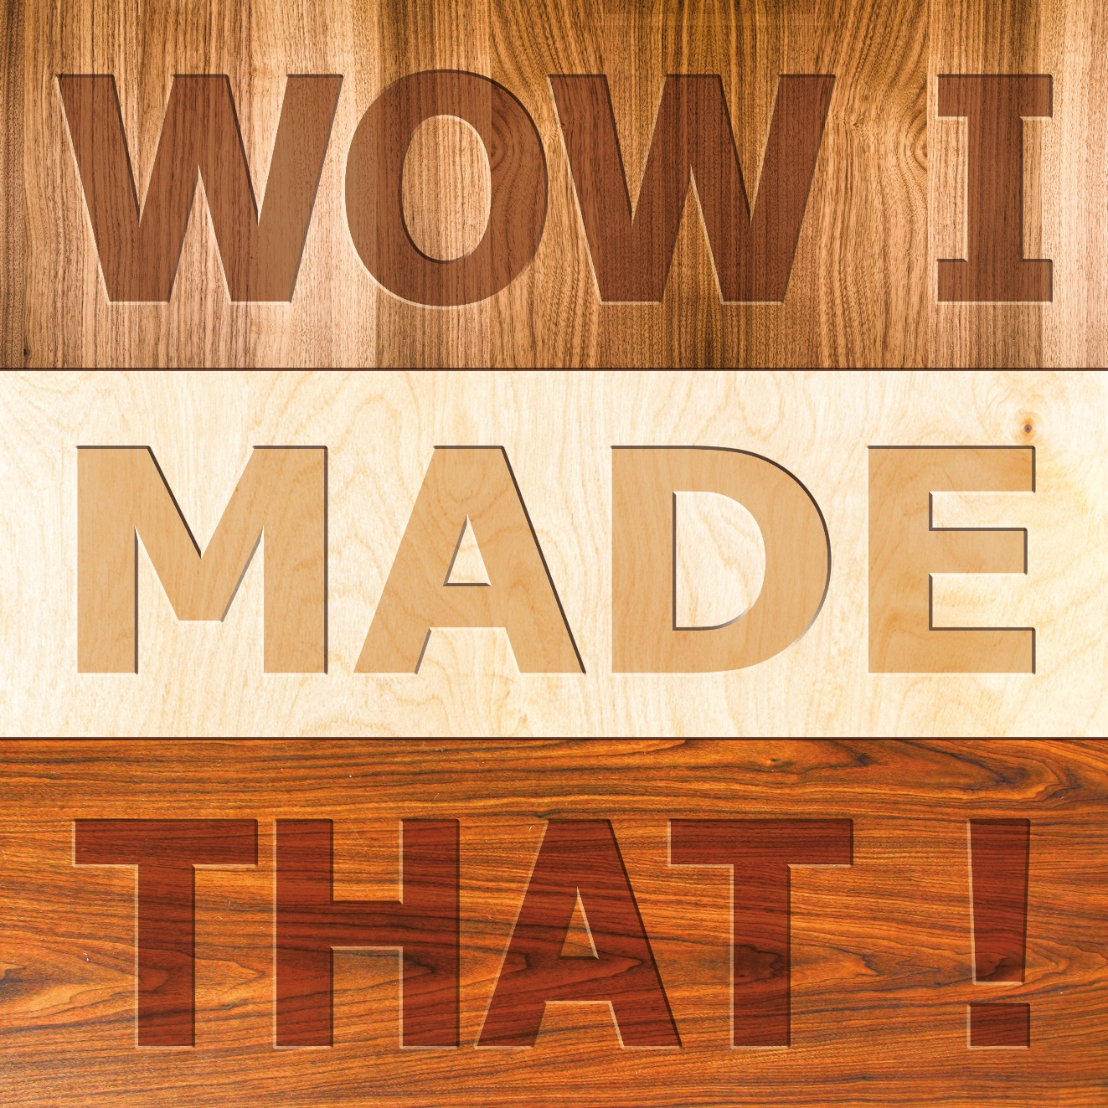
Particle Board Manufacture

Slide 2
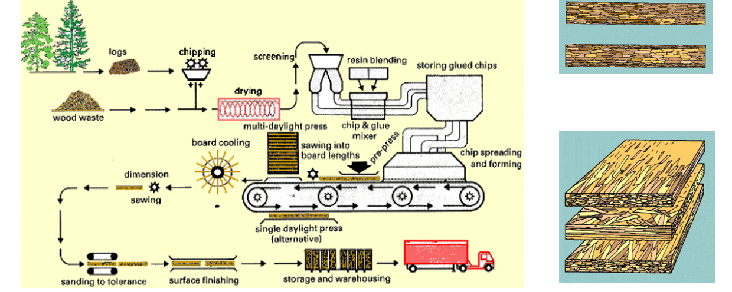
General Description
Essentially, particleboard (sometimes referred to as ‘chipboard’) is a type of manufactured wood made from compressed wood particles. It is made from a combination of post recycled consumer wood – such as planer shavings, offcuts or sawdust –mixed with resin which are formed into boards by curing in a heat press.

Slide 3
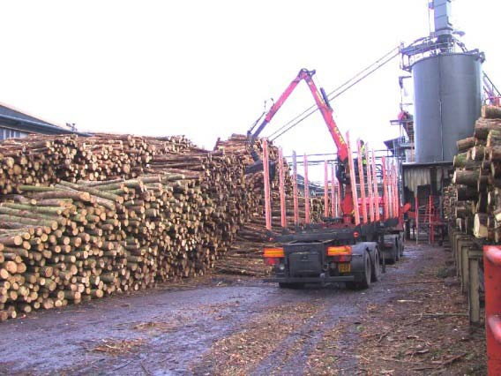
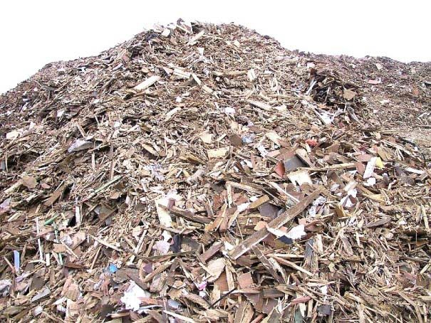
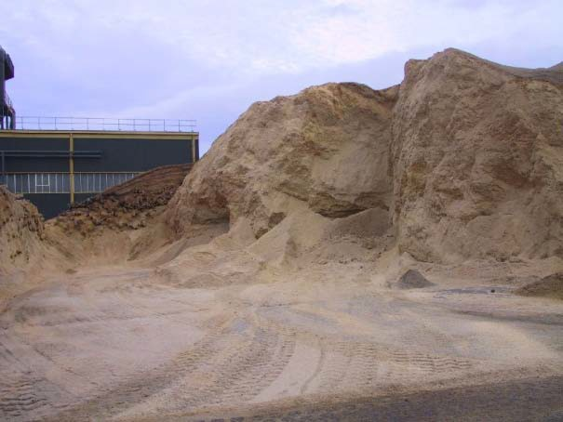
Particle Board Manufacture
Collection of raw materials
Roundwood logs are brought in by lorry from surrounding forests
Recycled wood is also brought in
Saw dust from local sawmills

Slide 4
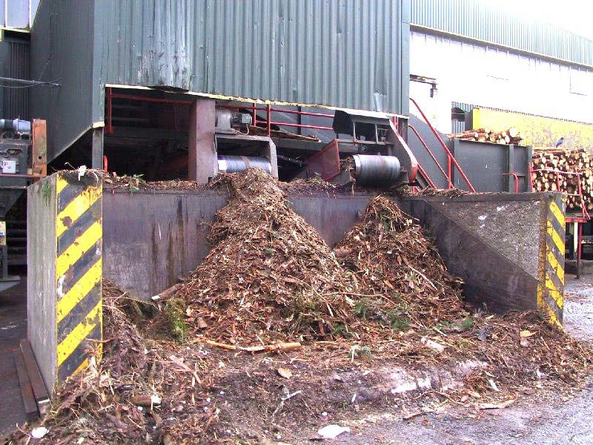
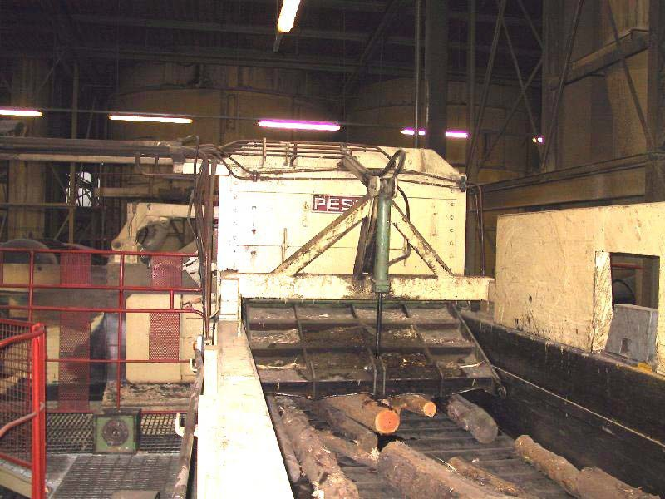
Particle Board Manufacture
Preparation of recycled wood
The roundwood logs are fed into a machine to remove bark and any grit/sand stuck to it
Logs are fed into the flaker machine and are shaved or cut to make wood flakes, chips and shavings

Slide 5
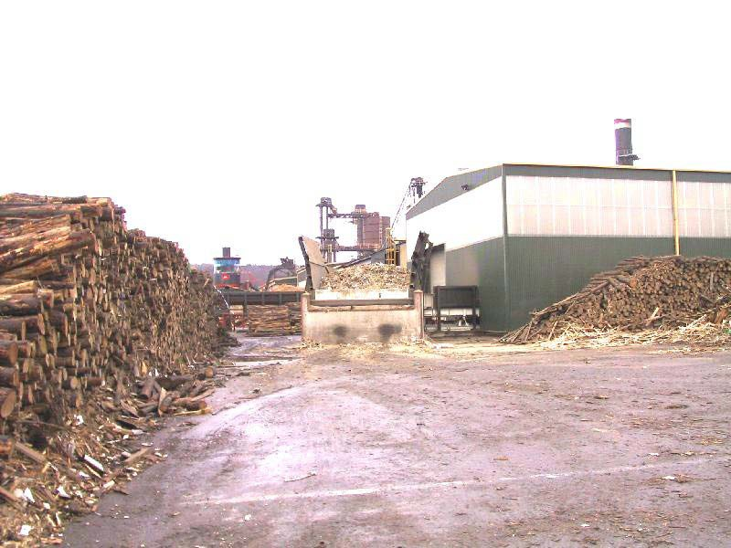
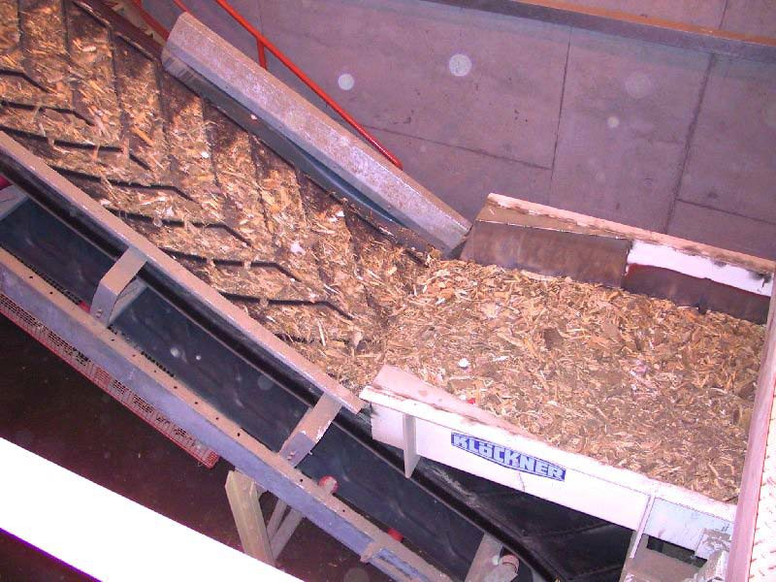
Particle Board Manufacture
Preparation of roundwood logs
The recycled wood is fed into Mill, which smashes the wood into woodchips with revolving metal hammers and discards all other waste products
Woodchips are passed up a conveyor and the metal, plastics and rags removed from the woodchips. A large magnet is used to remove the metal

Slide 6
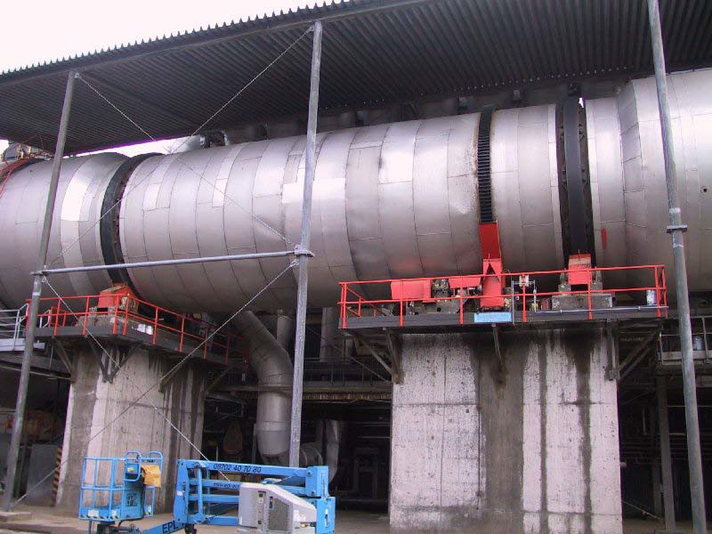
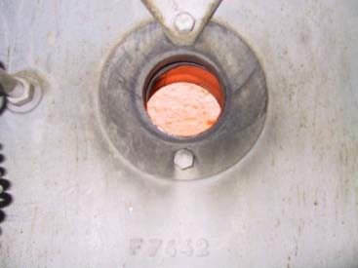
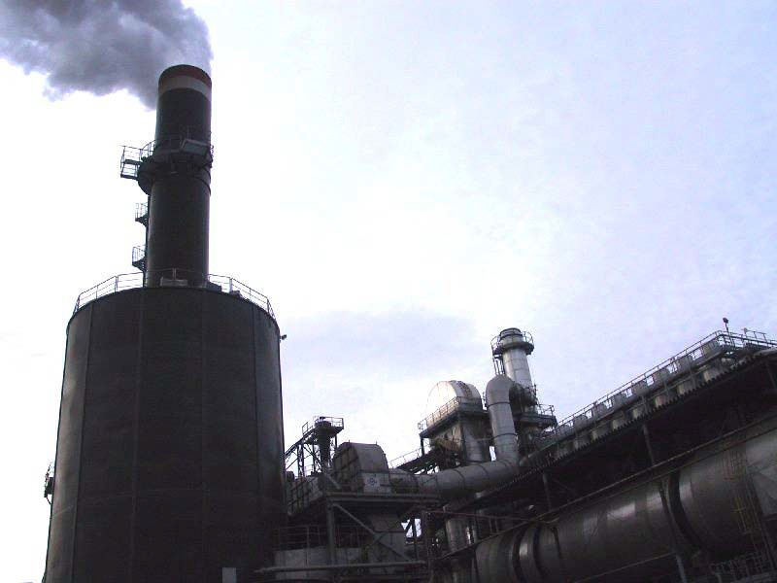
Particle Board Manufacture
Drying chips
Woodchips from the recycled timber and logs are dried in a big drum by hot air produced from burning the very fine waste wood dust
Birds eye view into the burning chamber which creates the heat to dry the wood chips
Removes the pollutants and dust from the wood drying process

Slide 7
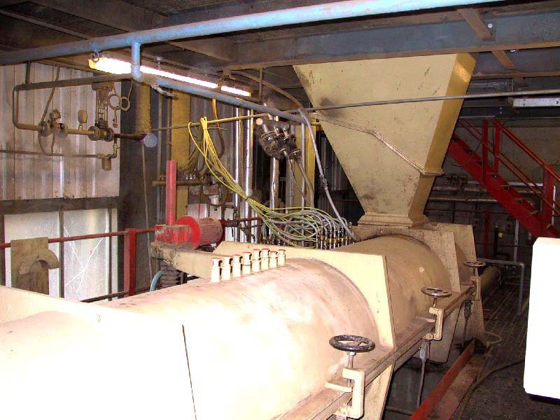
Particle Board Manufacture
Mixing chips with synthetic resin
The wood chips are now mixed with glue and wax. The glue is used to bond the chips together and the wax makes the chipboard water resistant

Slide 8
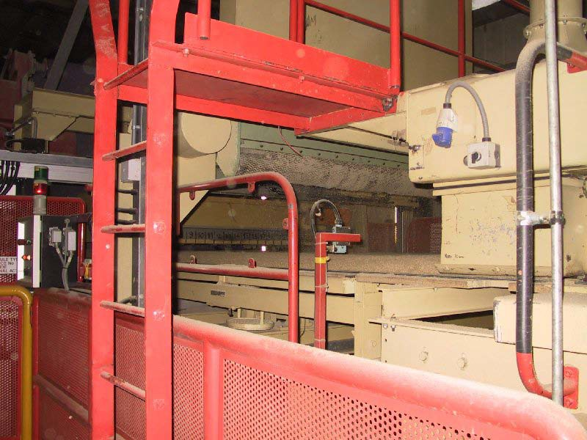
Particle Board Manufacture
Pressing chips
The wood chips are now ready for pressing and are fed into a forming station and then into a conveyor belt called a forming line

Slide 9
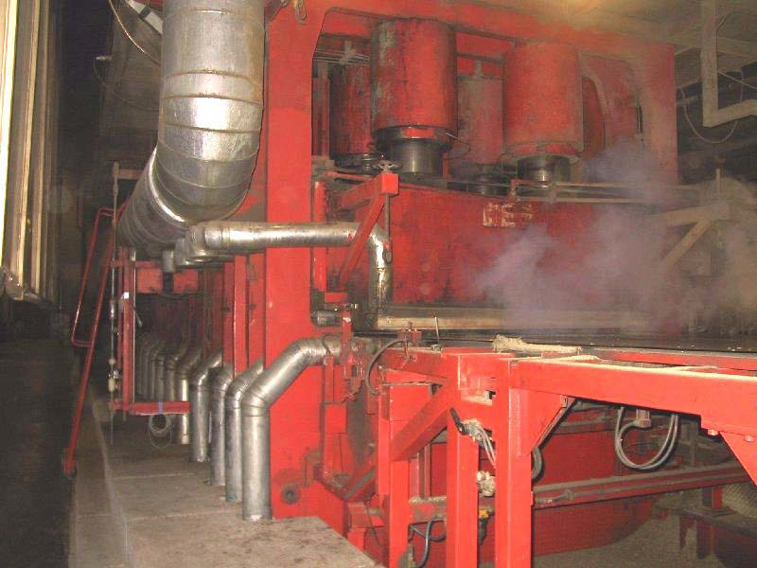
Particle Board Manufacture
Applying heat to press
From the forming line the chipboard moves to a pressing plant where the moisture is driven off and board is pressed at high temperature and pressure in the main process.

Slide 10
Particle Board Manufacture
Dimensioning
The edges of the board are trimmed and the board cut into large panels before being cooled, sanded and packed for storage in the warehouse.

